Slide 1
Brief look at three real-world uncertainty propagation case studies
Pesticide leaching in soil
Streamline network derivation from a digital elevation model
Geometric correction of airborne imagery

Slide 2
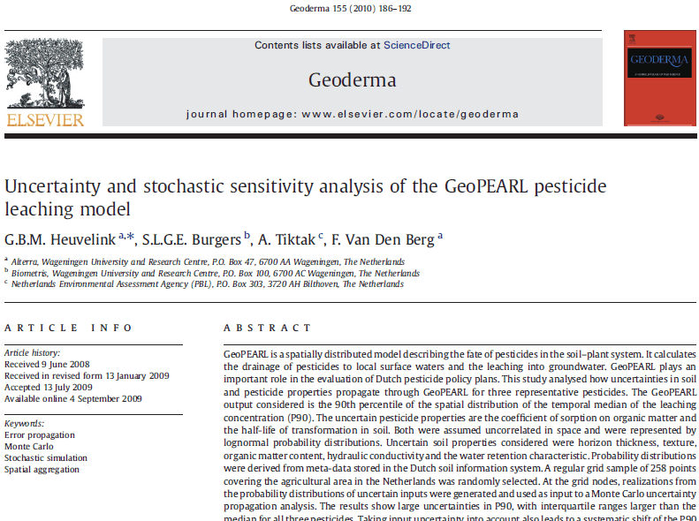

Slide 3
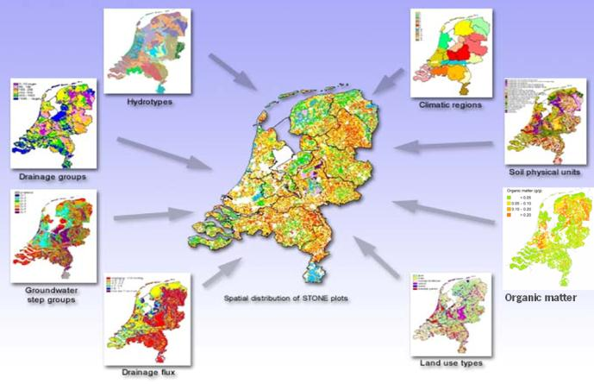
GeoPEARL has many inputs: mainly soil, landuse, climate and hydrology

Slide 4
GeoPEARL inputs considered uncertain:
Soil properties:
Horizon thickness
Texture
Organic matter content
Hydraulic conductivity
Water retention characteristic
Pesticide properties:
Half-life of transformation in soil
Coefficient of sorption on organic matter

Slide 5
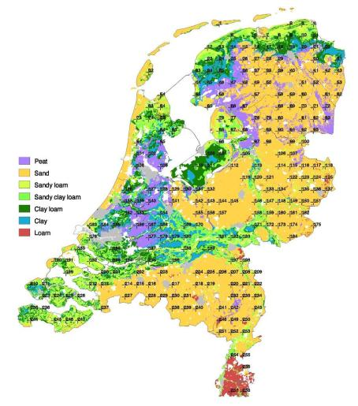
Netherlands represented by a grid sample of 258 points
At each point 1000 Monte Carlo runs of GeoPEARL
Next the 90 percentile (P90) of 258 GeoPEARL outputs computed for each of the 1000 runs
Variability in the 1000 P90 values conveys uncertainty about true P90

Slide 6
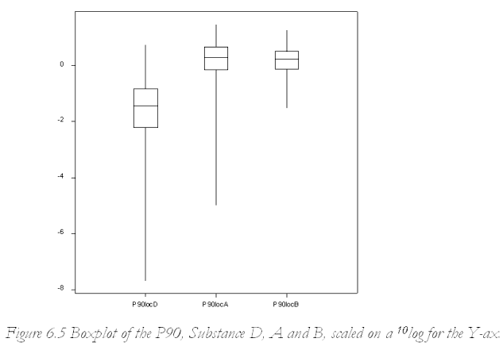
Uncertainty in GeoPEARL output
Large uncertainty in P90, particularly for substance D
Box-plots straddle the regulatory limit of 0.1 μg∙l⁻¹
Risk-aversive policy would reject all three pesticides
D
A
B

Slide 7
Pesticide properties are main source of uncertainty
Percentage variance explained by uncertain inputs
 | Organic matter | Other soil properties | Half-life | Sorption
Substance D | 0 | 0 | 60 | 20
Substance A | 7 | 1 | 54 | 41
Substance B | 7 | 0 | 87 | 10

Slide 8
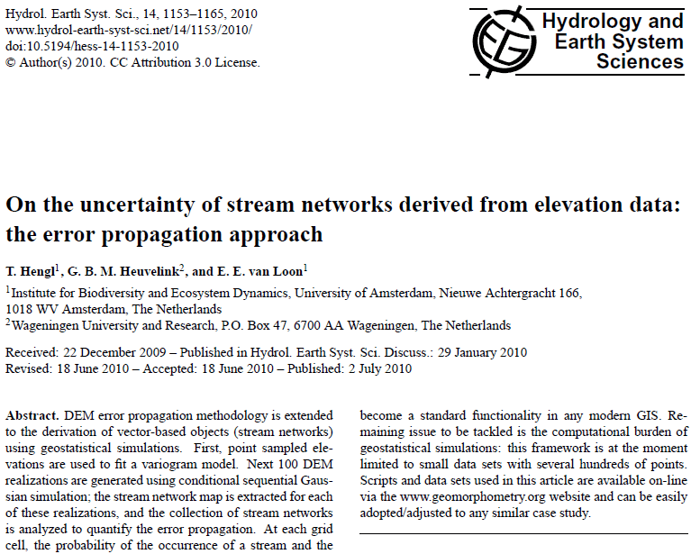
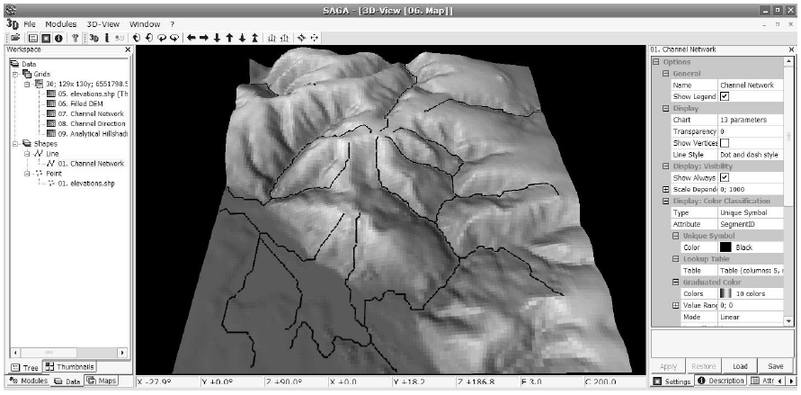

Slide 9
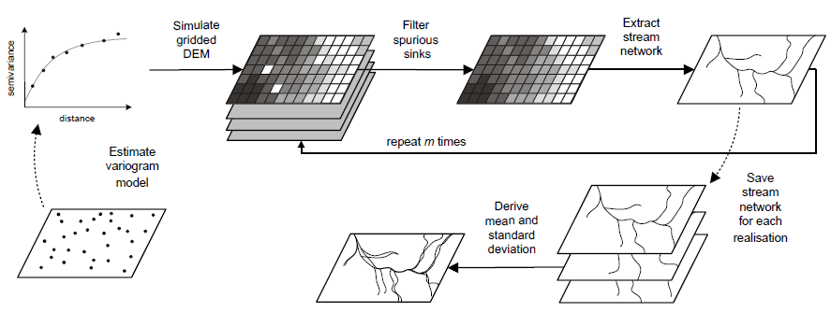
Monte Carlo approach as before

Slide 10
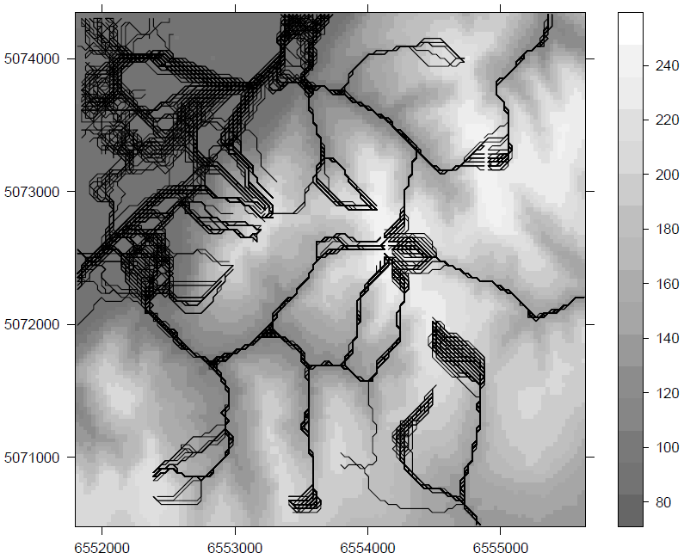
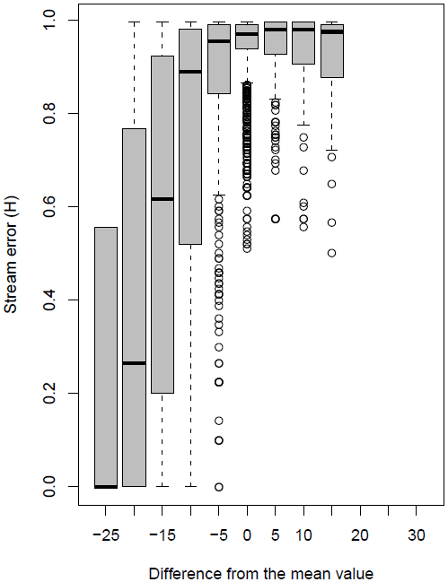
100 realisations of stream network and error box plots for curvature classes
concave
convex

Slide 11
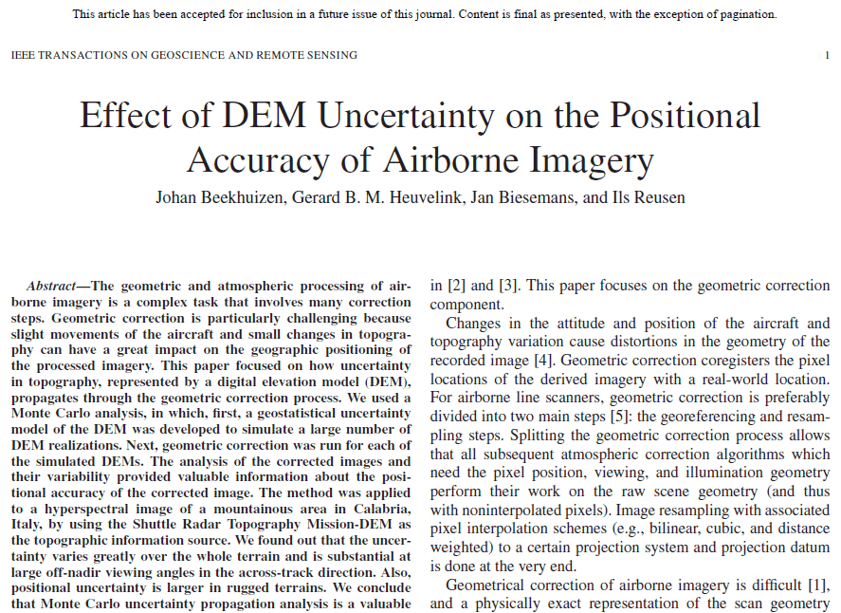
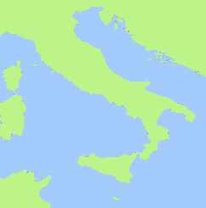
Italy
Study area

Slide 12
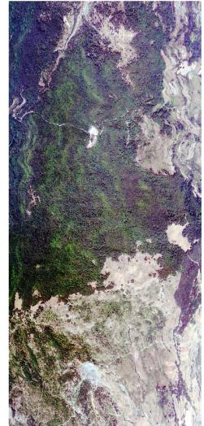
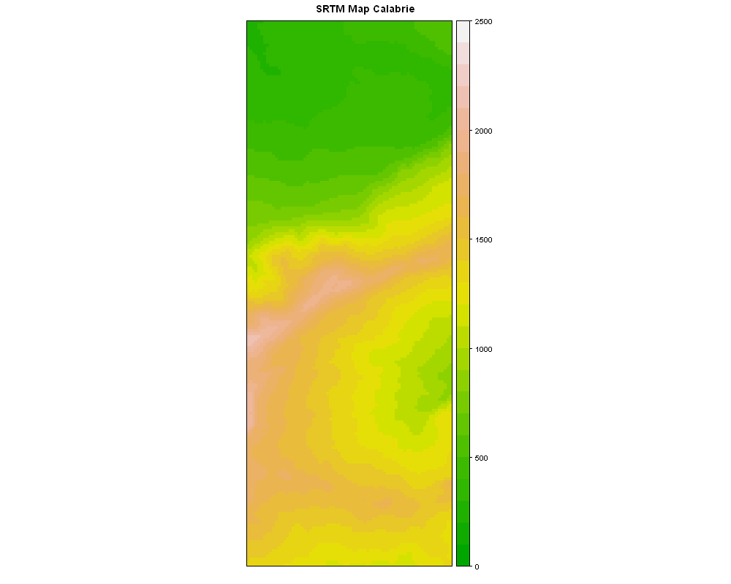
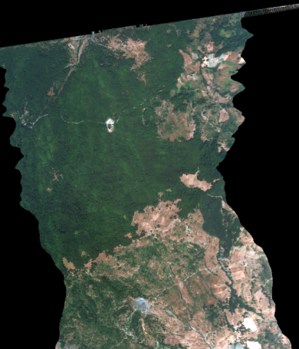
Geometric correction with an elevation map (DEM)
Height (m)
2500
2000
1500
1000
500
0

Slide 13
PDF input parameters
Uncertainty
Propagation
Analysis
Sample from PDF
N samples
PAF
Level0 product
Run Model 1 N times
Level 1 product
Run Model 2 N times
Level 2 product
Quality layers
Analyse

Slide 14
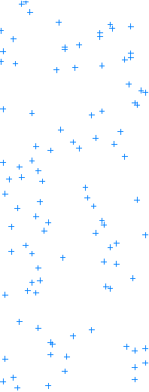
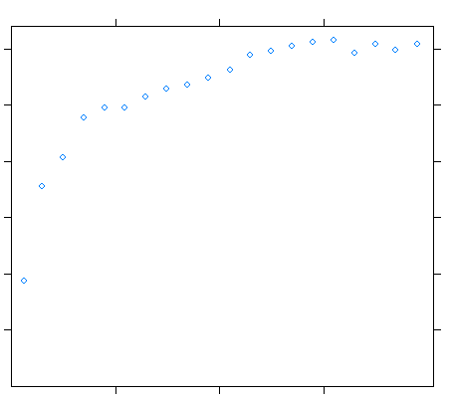
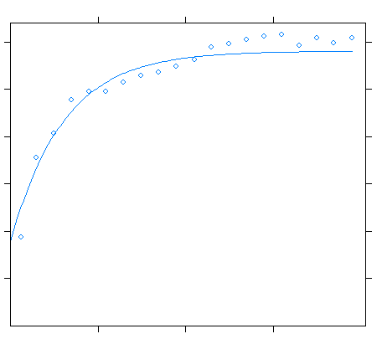
Uncertainty Digital Elevation Model (DEM) Create a Probability Distribution Function (PDF)
Height (m)
2500
Create variogram
60
2000
50
Semivariance
40
1500
30
20
10
1000
10
20
30
Distance (in pixels)
500
Variogram defines how DEM error is
correlated with distance → Spatial correlation
Temme et al. 2009, Geostatistical Simulation and Error Propagation in Geomorphometry
0
Notes:
Spatial correlation: modeled by variogram; Variogram defines how DEM error is correlated with distance

Slide 15
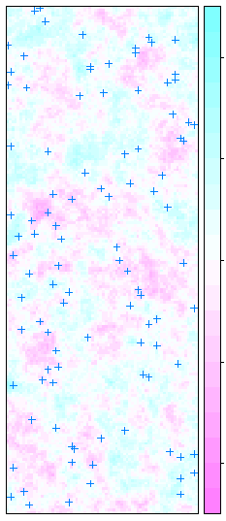
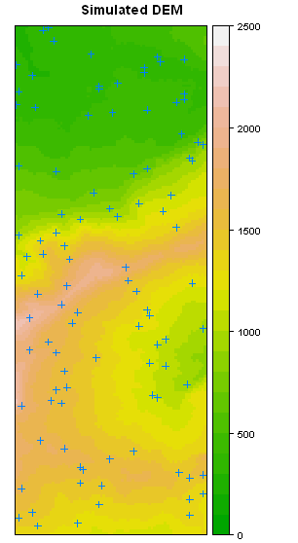

Uncertainty Digital Elevation Model (DEM) Generate samples of uncertain inputs
Control Points
Error map
Simulated DEM
Error (m)
Original DEM
Height (m)
2500
40
2000
20
1500
0
1000
-20
500
-40
0

Slide 16
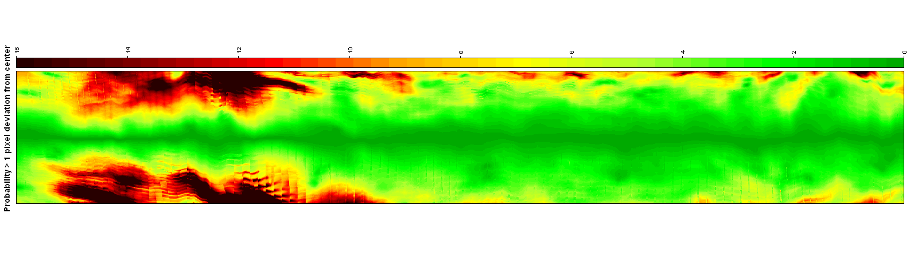
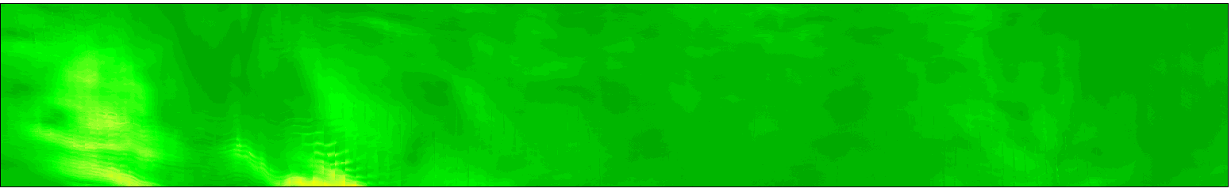
Magnitude of errors in x- and y-coordinates larger in off-nadir angles and in mountainous parts of the study area
Standard deviation X-coordinates
Sd (m)
16
Standard deviation Y-coordinates
8
0

Slide 17
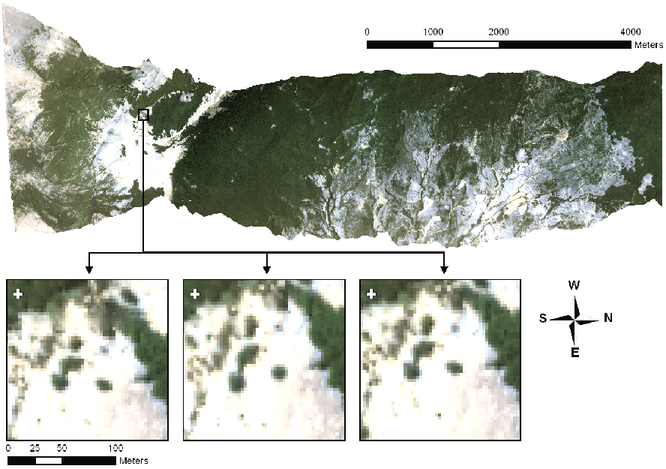
Zooming in shows effect of DEM error on geometric correction

Slide 18
Zooming in shows effect of DEM error on geometric correction

